Slide 1
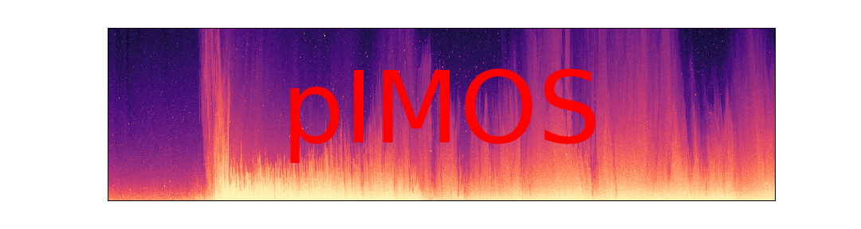
DATA ARCHIVING
Kimberley 2017; Pilbara 2019

Slide 2
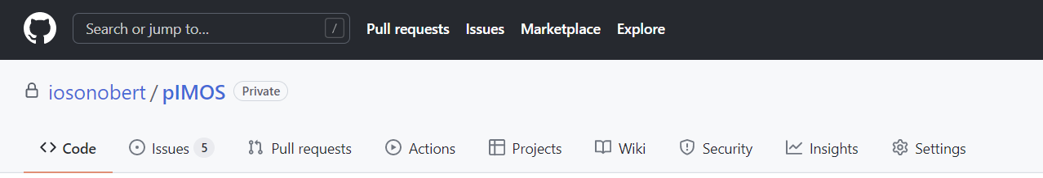
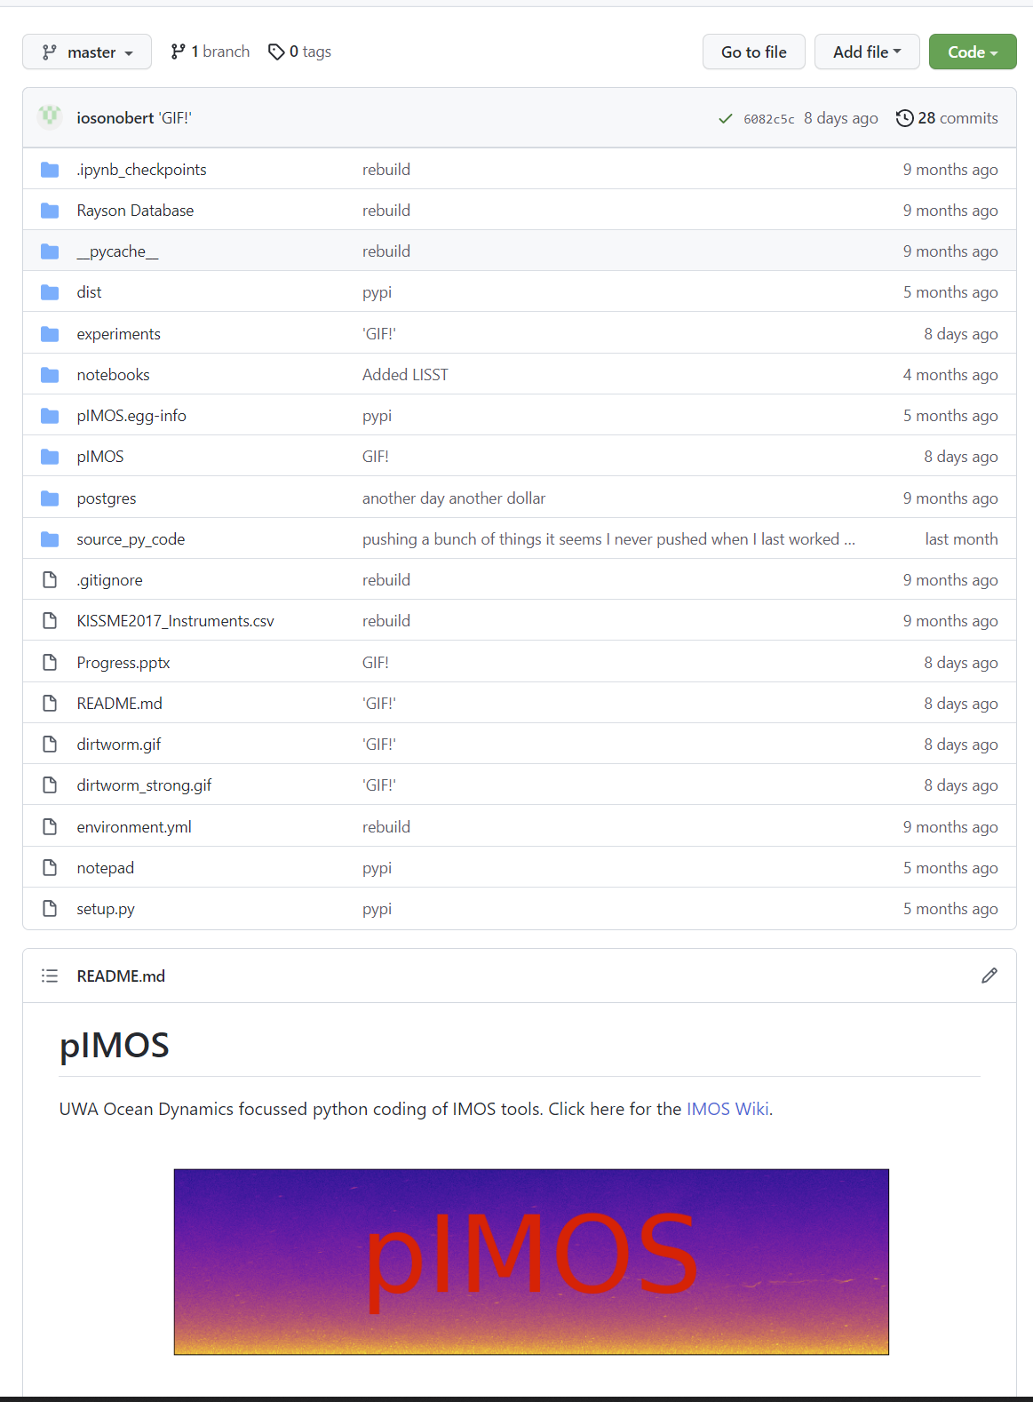
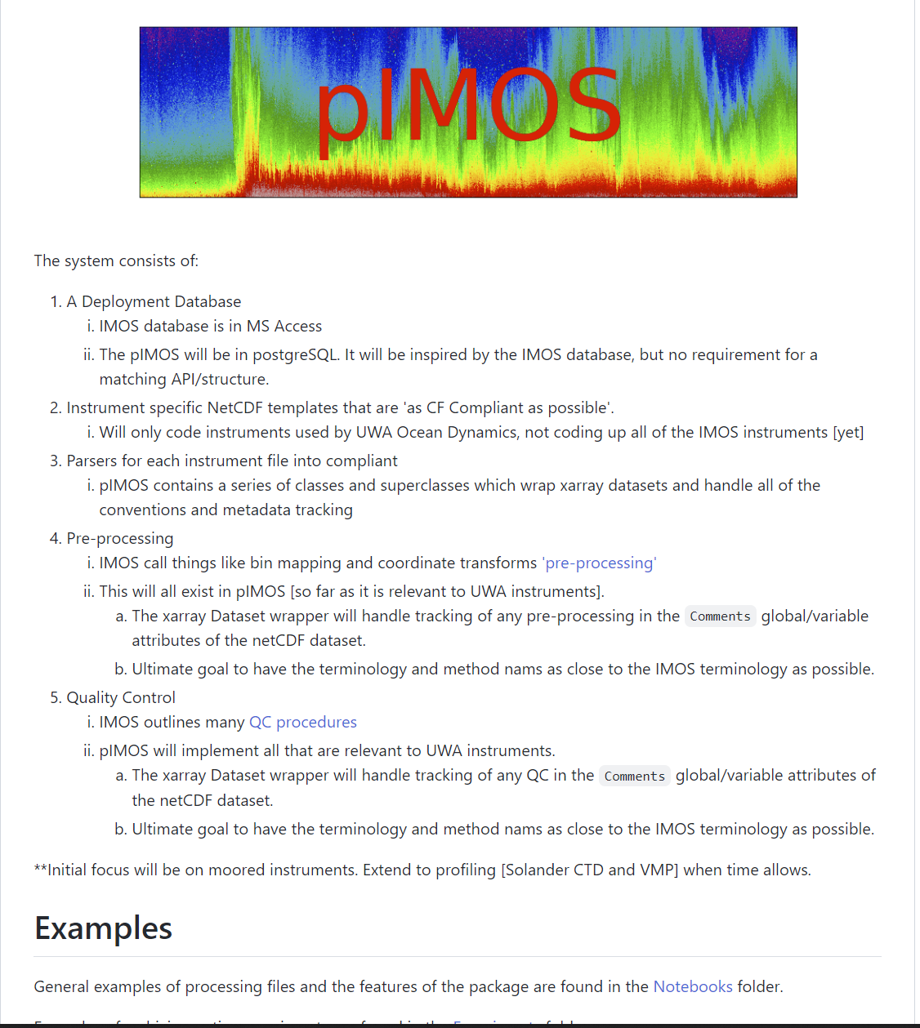
Elements
All KISSME and RS19 files saved into a common netcdf format
Same QC conv
Same metadata attributes
CF compliant
IMOS inspired
Robust python library [pIMOS] on GitHub to handle:
The reading/parsing from
Single CSV logbook for autonomous instrs
Single CSV logbook for profiling instrs
Preference for binary readers
The data structures
QC interface
Metadata logging
History tracking
Etc.
Utilities:
Basic timeseries analysis
Complete suite of automated QC routines (use IMOS)
CF compliance checker
UWA Archiving utilities
Instrument Specific Utilities
Rotations, transforms, bin mapping, calibrations, decomvolutions
Open-source SQL integration
Code first SQL database that can be spun up when we find a host
Routines for:
Mooring stacking
Transect stacking
Linked Examples for:
More advanced/bespoke timeseries analysis
More advanced/bespoke Cleaning/QC [GN, phase unwrapping]
All turbulence calcs
Modal fitting
Energy/energy flux calcs
Instruments
TRDI Longranger
TRDI Quartermaster
TRDI Sentinel
TRDI Monitor
Nortek Vector
Nortek Signature [Broadband]
Nortek Signature [Pulse Coherent]
Rockland VMP 250
WETLABS FLNTU
LISST200X
SBE37CTD
SBE37CT
SBE39
SBE39+
SBE56
SBE911 [Solander Livewire]

Slide 3
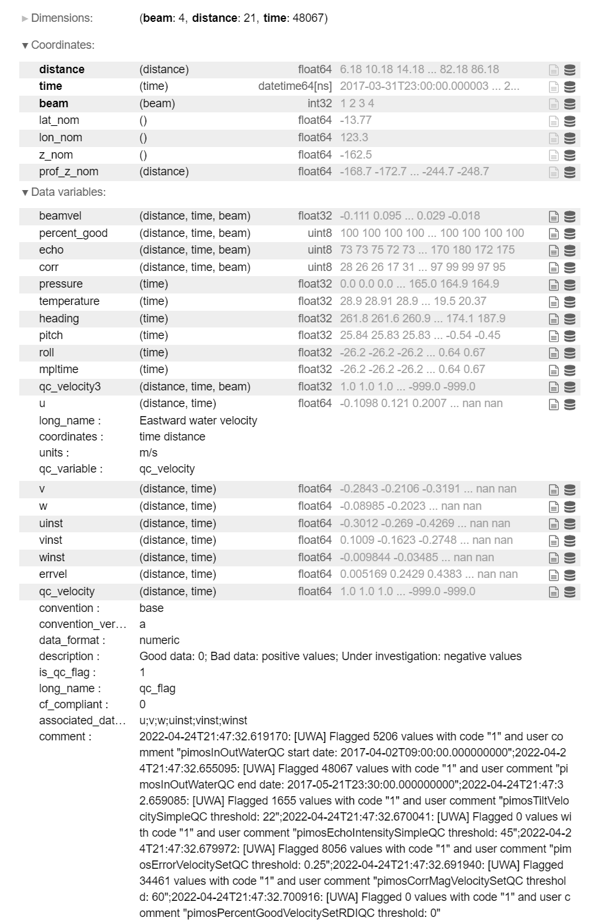
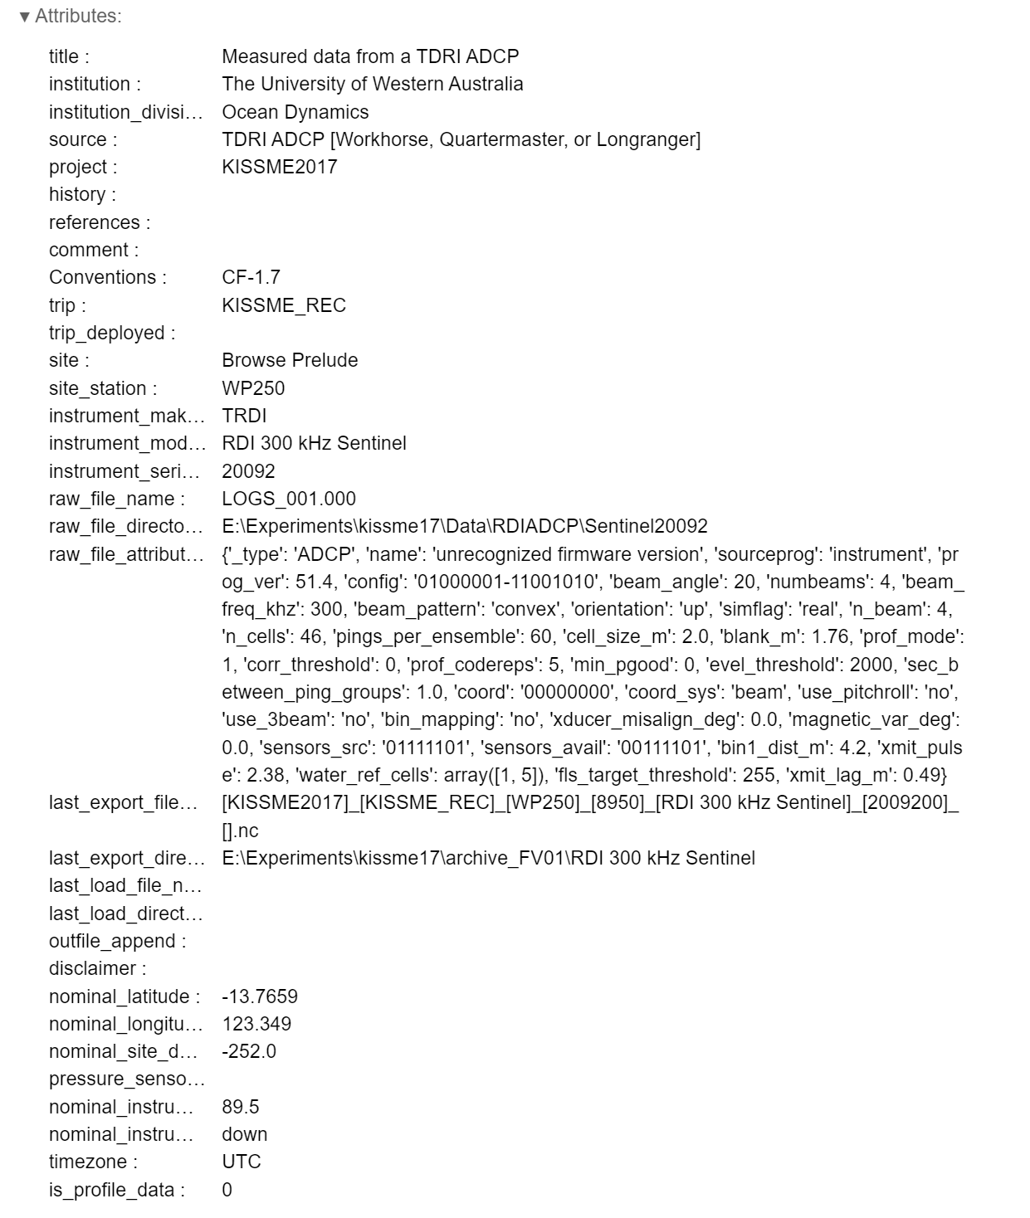
Example pIMOS NetCDF File
Could always take it further
Variable u
[CF COMPLIANT]
Associated qc variable
Variable qc_velocity
Code meaning [Decision needed]
Naming conv
Is CF compliance enforced? [Default is yes]
Which variables is it associated with?
Could always take it further
Comment on QC. Which QC functions were run? What inputs used? When? Outcome?
Could always take it further

Slide 4
Process Levels: Workflow
Metadata Database
Contains all deployment info but also maybe some info about corrections (e.g. clock offset) to automate re-processing
Process Level 1
[Quality Controlled Data]
Real units and base QC
Process Level 2
[Derived Products]
100% automated to get to this point
Process Level 3
[Interpreted products]
Process Level 4
[Knowledge Products]
Filtered or smoothed data?
Process Level 0
[Raw Data]
Standard Format. Otherwise Raw.
Unwrapped, despiked and replaced etc.
Stacked moorings
Merged ADCPs
Turbulence Calcs
Modal Amplitude
‘Background’ quantities
Can change anything and the processing can be automatically rerun for a whole expt. [keeping old versions]
Researchers can deviate from the path at any point, make their own changes, and these may or may not become the new-normal

Slide 5
File attrs
Attribute | Process Level 0 | Process Level 1 | Process Levels 2, 3, 4
title | YES | YES | YES
institution | YES | YES | YES
source | YES | YES | YES
Project | YES | YES | YES
History | YES | YES | YES
References | YES | YES | YES
comment | YES | YES | YES
trip | YES | YES | OPTIONAL
trip_deployed | YES | YES | OPTIONAL
site | YES | YES | YES
site_station | YES | YES | YES
instrument_make | YES | YES | OPTIONAL
instrument_model | YES | YES | OPTIONAL
instrument_serial_number | YES | YES | OPTIONAL
raw_file_name | YES | YES | OPTIONAL
raw_file_directory | YES | YES | OPTIONAL
raw_file_attributes | YES | YES | OPTIONAL
last_export_file_name | YES | YES | YES
last_export_directory | YES | YES | YES
last_load_file_name | YES | YES | YES
last_load_directory | YES | YES | YES
nominal_latitude | YES | YES | YES
nominal_longitude | YES | YES | YES
nominal_site_depth | YES | YES | YES
pressure_sensor_height_asb | YES | YES | OPTIONAL
nominal_instrument_height_asb | YES | YES | OPTIONAL
nominal_instrument_orientation | YES | YES | OPTIONAL
Timezone | YES | YES | YES
process_level | YES | YES | YES
is_profile_data | YES | YES | YES

Slide 6
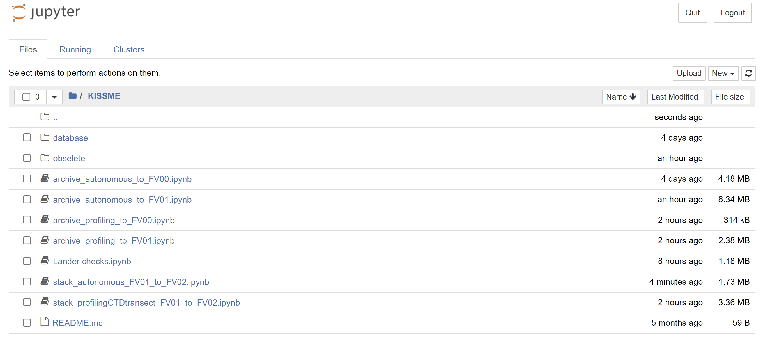
Process Levels: Workflow

Slide 7
Coding Progress to Date :
The base data structure class
Instrument specific classes for all moored and profiling instruments
RSI Microstructure python libraries was not an insignificant amount of work
Having multiple readers [e.g. for handling corrupt files] all plug into the one system cleanly was not an insignificant amount of work
Automation of CSV database to “Process Level 1” for all autonomous instruments
Automation of CSV database to “Process Level 0” for all profiling instruments
CSV database to PostgreSQL database – should we wish to take that route in the future
All IMOS QC routines
CF compliance utils and checker [seriously dry work!]
Stack moorings and transects
All of the higher process level tools [e.g. turbulence calcs, modal fitting] are coded in Python also – they just need to be plugged in
Actual Archiving Progress to Date:
Kimberley 2017 profiling VMP and LISST data archived to “Process Level 0”
Kimberley 2017 profiling CTD data archived to “Process Level 1”
Kimberley 2017 autonomous data archived to “Process Level 1”
Kimberley 2017 mooring stack archived to “Process Level 2”
Kimberley 2017 CTD transect stack archived to “Process Level 2”
Kimberley 2017 Turbulence calcs done [from “Process Level 1” inputs]
Pilbara 2019 autonomous data archived to “Process Level 1”

Slide 8
Process Levels – KISSME 2017
Black=done; Blue=code tested but not in workflow; Orange = code needs further testing; Red=Known Issues
PL | Seabird 37, 39, 56 | Teledyne RDI | Signature | Vectors | Wetlabs | LISST [moored and profiling] | Profiling CTD | Profiling VMP
0 | * | * | * | * | * | Read Build structure Add attributes Export | * | Read Deconvolve Physical Units Build structure Add attributes Export
1 | Read Build structure CF compliance Assign QC Add attributes Calibrate InOutWaterQC Export as PL1 | Read Build structure CF compliance Assign QC Add attributes InOutWaterQC TiltVelocitySimpleQC EchoIntensitySimpleQC ErrorVelocitySetQC CorrMagVelocitySetQC PercentGoodVelocitySetRDIQC Export as PL1 | Read Build structure CF compliance Assign QC Add attributes InOutWaterQC TiltVelocitySimpleQC EchoIntensitySimpleQC CorrMagVelocitySetQC ALONG-BEAM FISH DETECTION. Export as PL1 | Read Build structure CF compliance Assign QC Add attributes InOutWaterQC FishDetectionQC CorrMagVelocitySetQC Export as PL1 | Read Build structure CF compliance Assign QC Add attributes _calibrate_device InOutWaterQC Export as PL1 | CF compliance Assign QC qc_routines Export as PL1 | Read Build structure Add attributes CF compliance Assign QC qc_routines Export as PL1 | CF compliance Assign QC qc_routines Export as PL1
2 | Goring Nikora? Time filter/align Stack Moorings*** Reexport as PL2 | ENU with BinMap Time filter/align Replace missing data Stack moorings*** Reexport as PL2 | Phase unwrap Goring Nikora Replace missing data ENU Reexport as PL2 | Phase unwrap Goring Nikora Replace missing data ***Tilt sensor correct ENU Reexport as PL2 | Burst Median? Goring Nikora? Reexport as PL2 |  | Stack Transect Reexport as PL2 | Goring Nikora? Replace missing Reexport as PL2
3** | Background quantities Modal fitting Reexport as PL3 | Modal/harmonic fitting Velocity shear calcs Scotti et al. 2005? Reexport as PL3 | Turbulence calcs Mean calcs Velocity shear calcs Scotti et al. 2005 Reexport as PL3 | Turbulence Calcs Mean calcs Frame interference? Reexport as PL3 |  |  |  | Turbulence Calcs Reexport as PL2
* These instruments go straight to Process Level 1
** My understanding is that these will be output to netcdf but not archived on library website etc
*** Not resaved as individual files at this point, straight into stacked files
**** The 6019 tilt sensor was broken. Tilt data is QCd out manually and commented. I’m running a ‘quick rotate’ routine on these data.

Slide 9
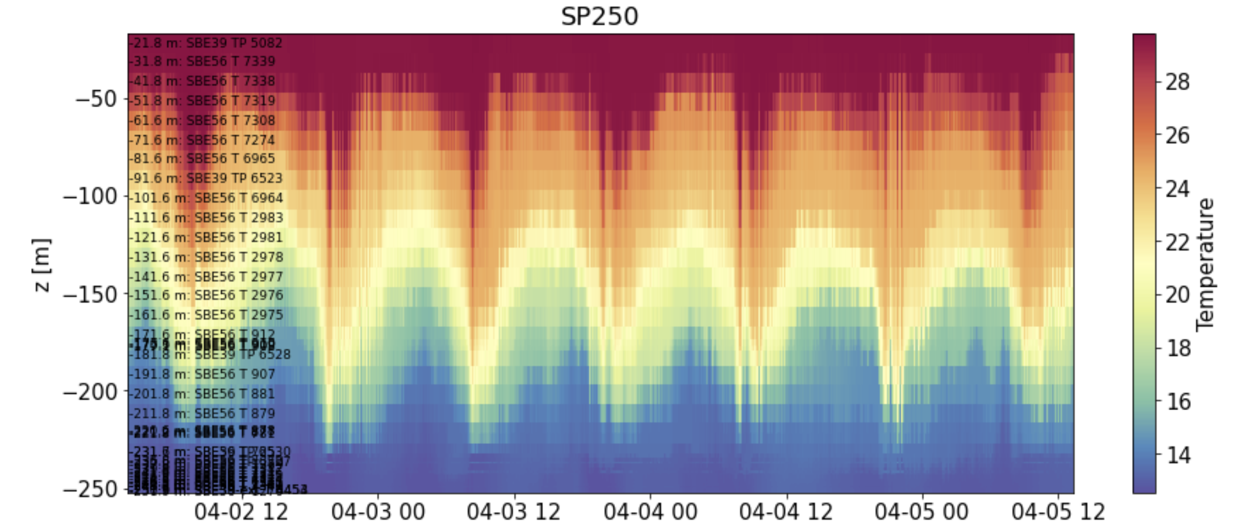
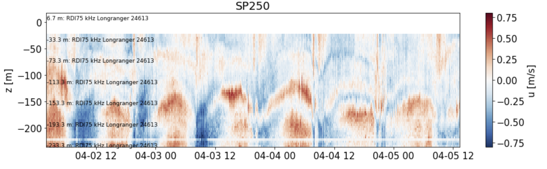
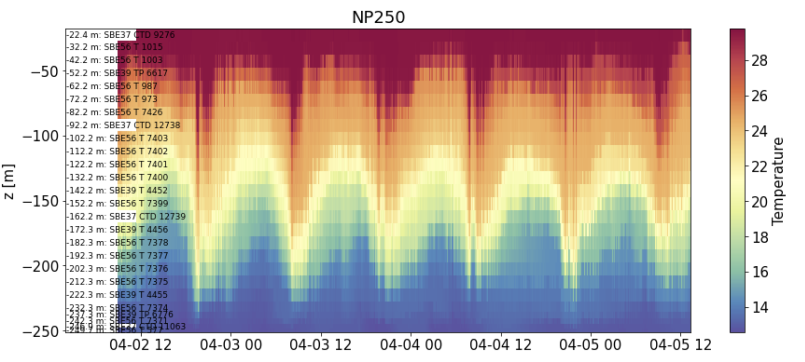
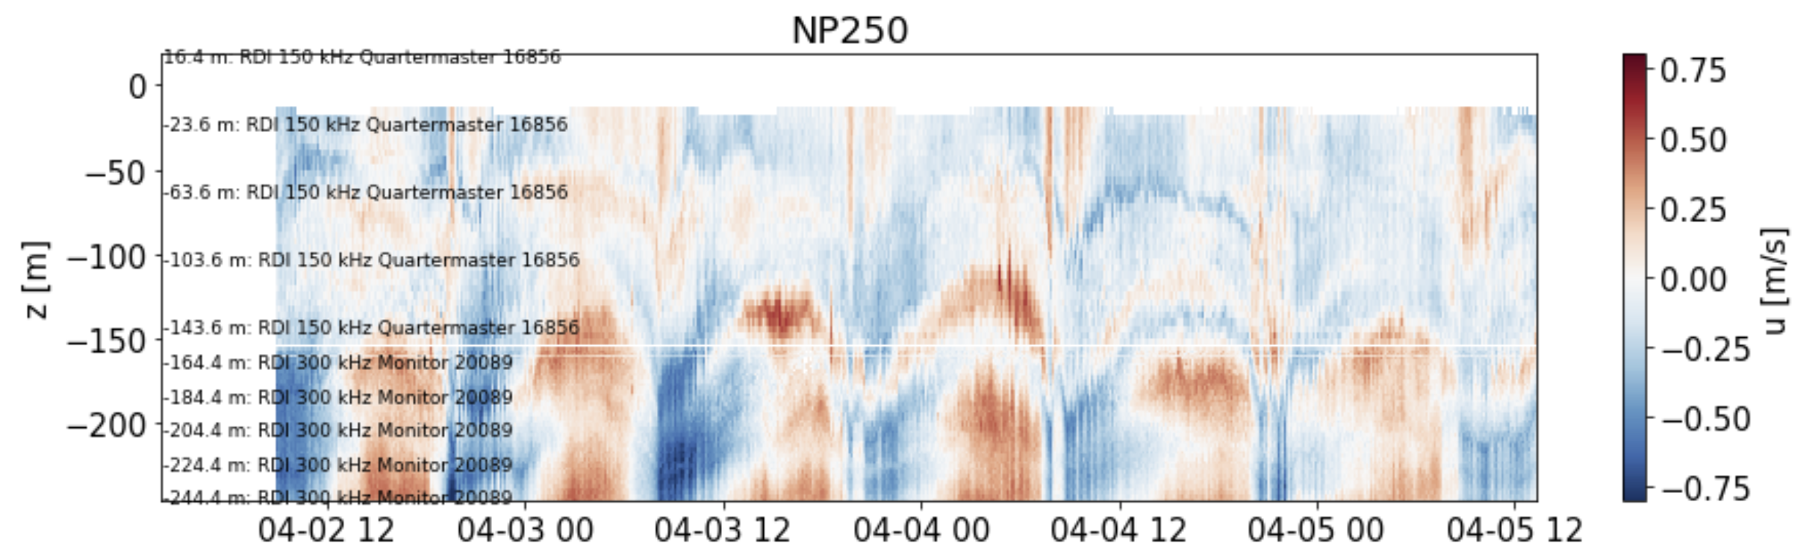
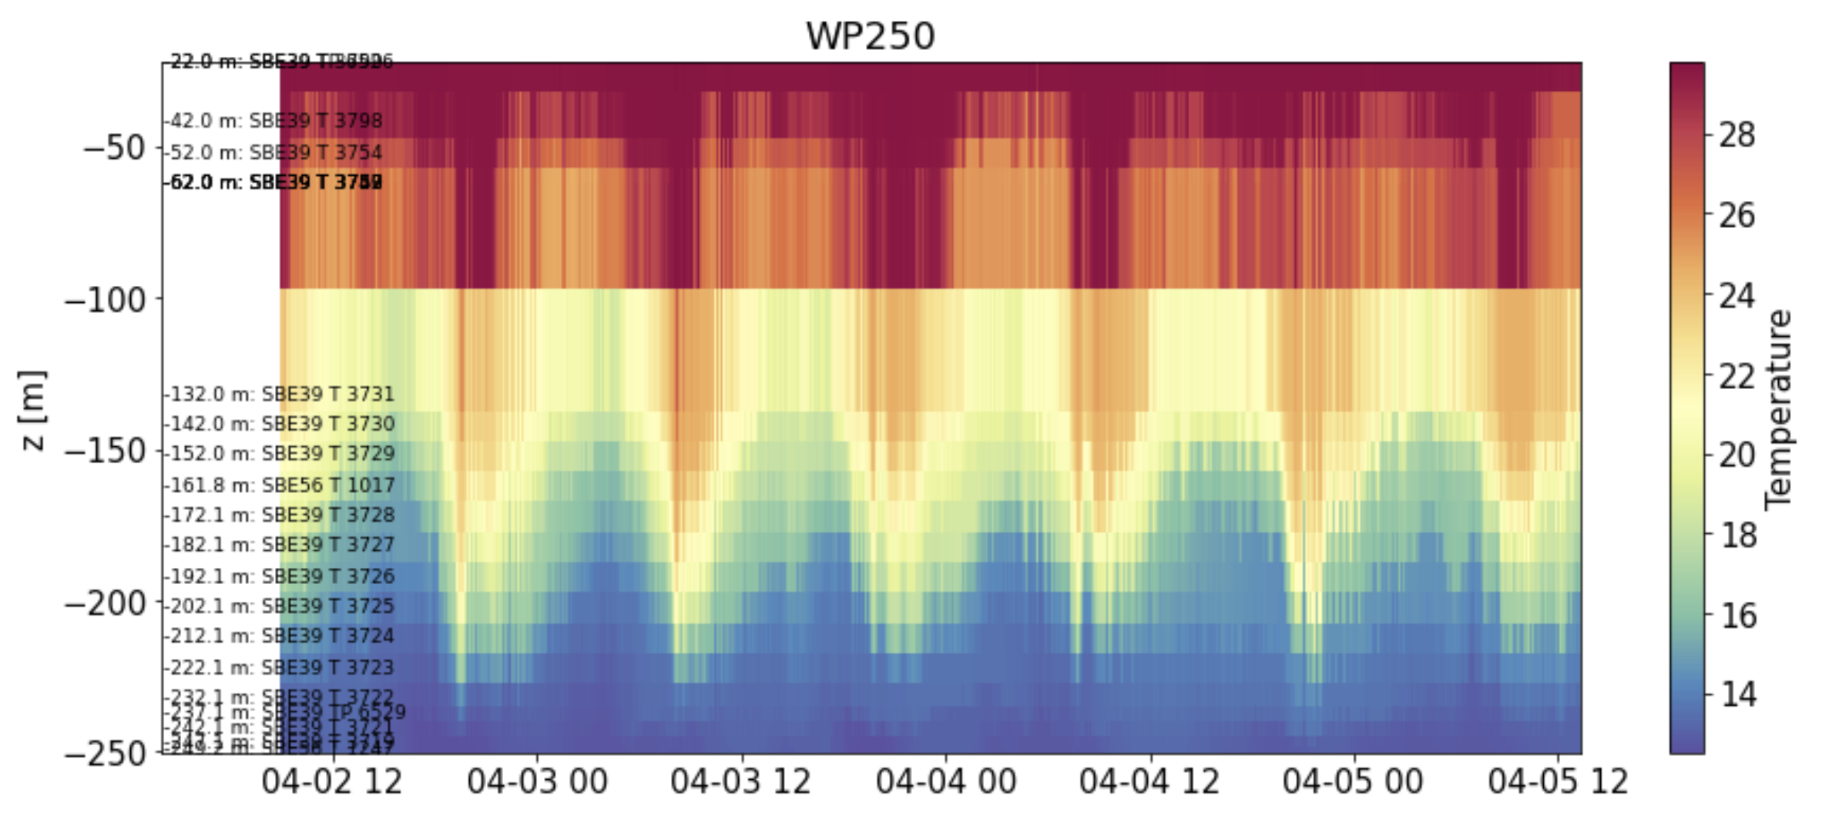
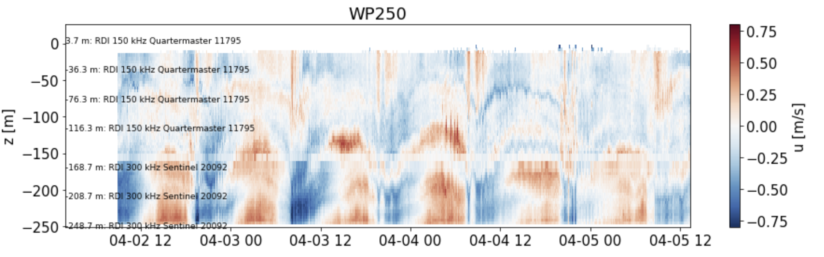
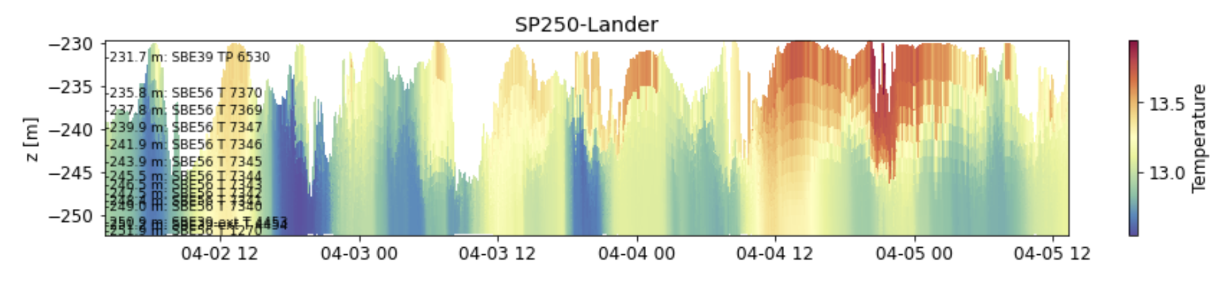
KISSME Stacked Moorings

Slide 10
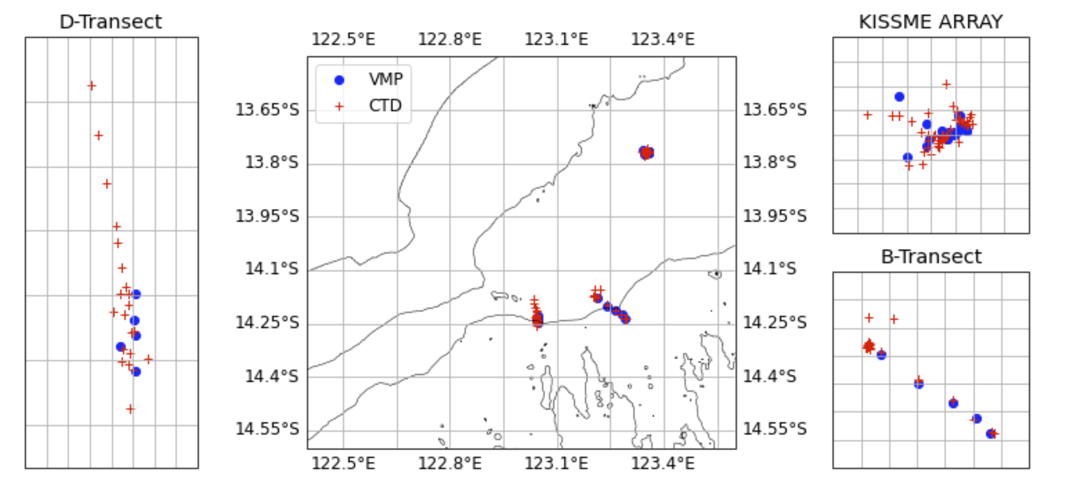
KISSME Profiler Casts

Slide 11
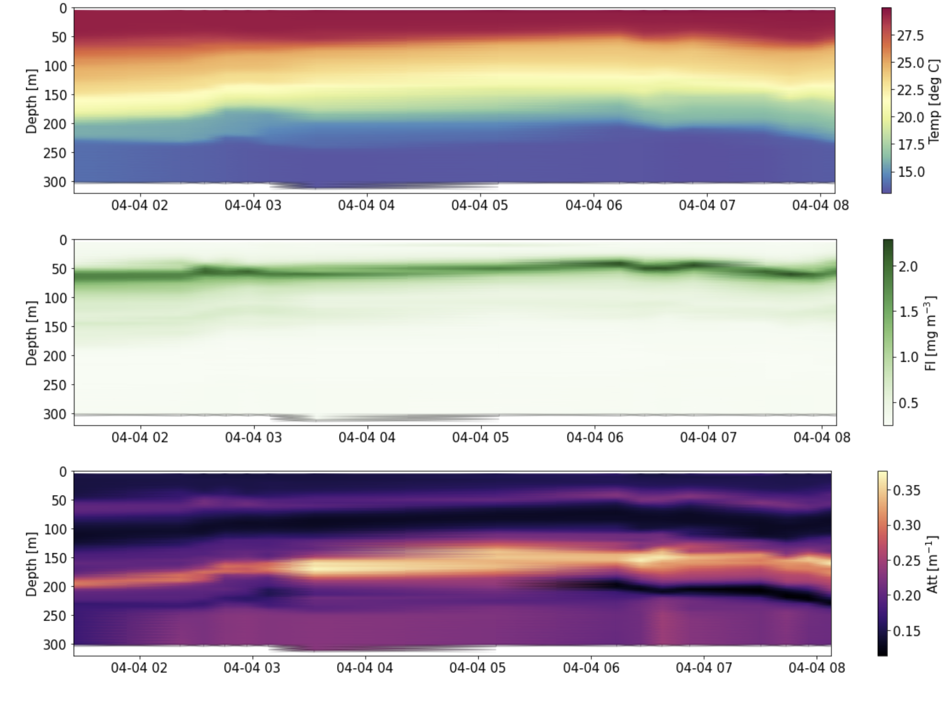
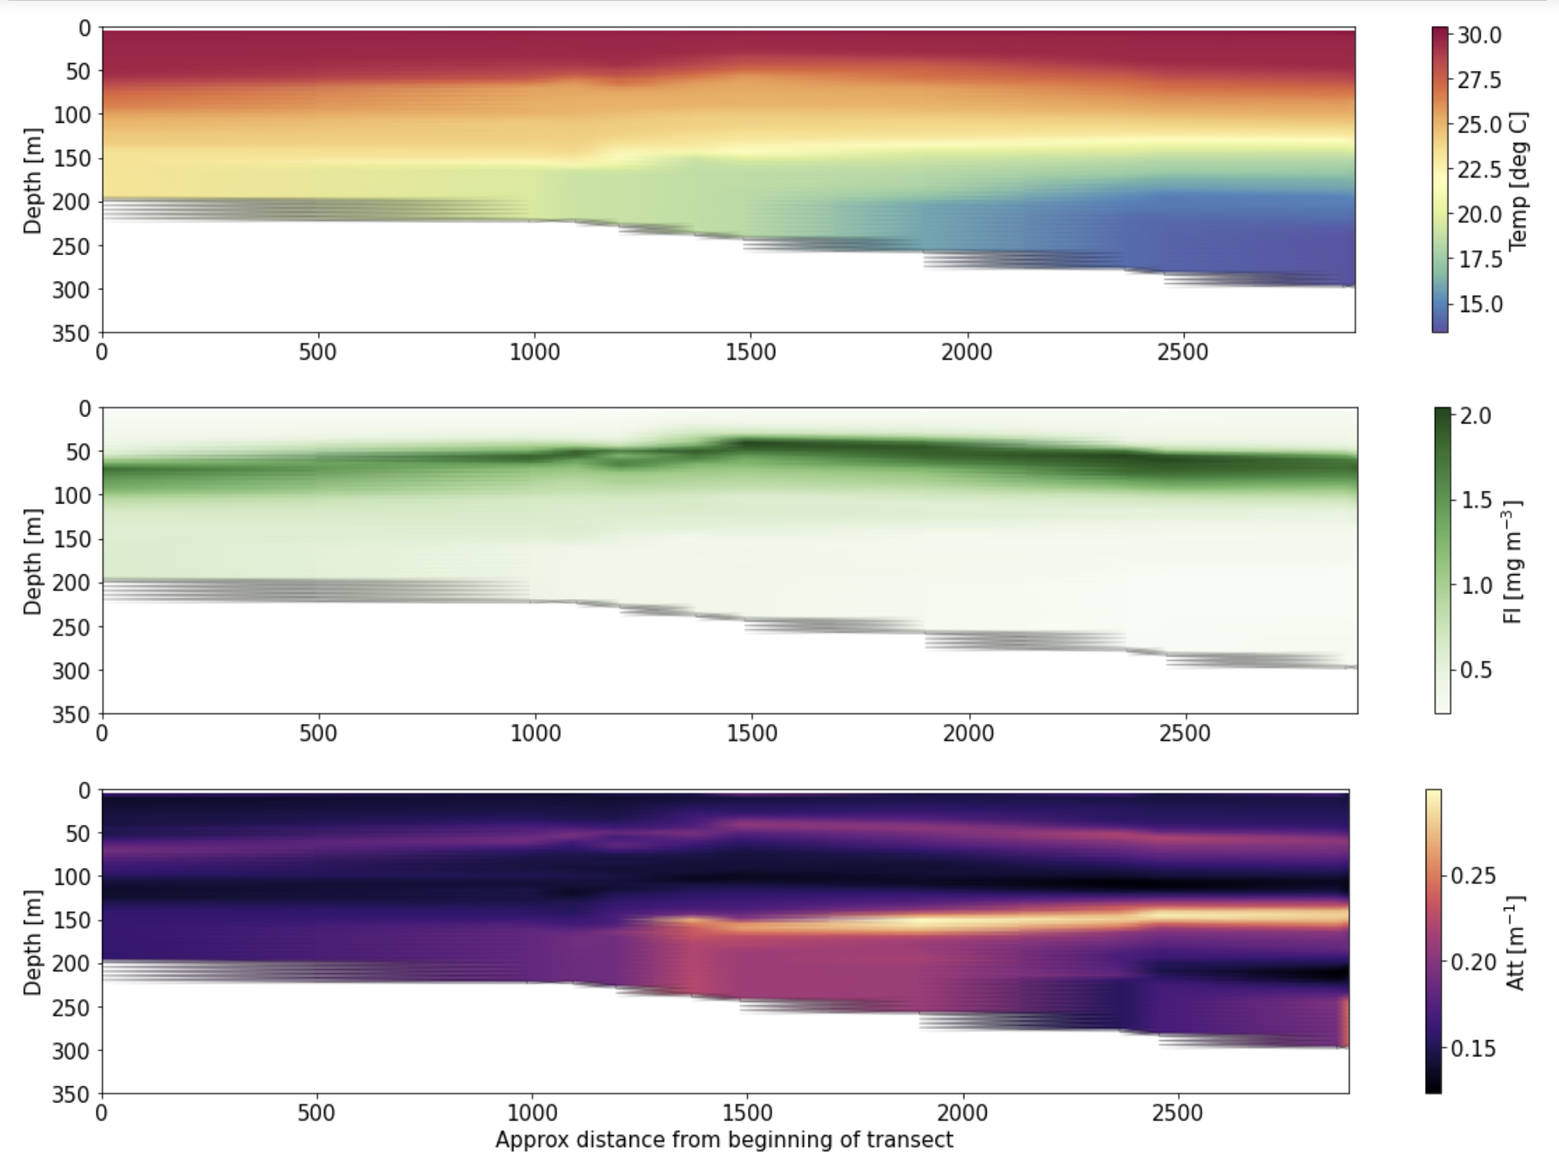
KISSME stacked transects

Slide 12
PILBARA 2019 OVERVIEW
PL | Seabird 37, 39, 56 | Teledyne RDI | Signature | Lander Vectors | Wetlabs | LISST [moored and profiling] | Profiling CTD | Moored Vector
0 | * | * | * | * | * | WAITING ON LOGS FROM WILL | * | WAITING ON INFO FROM CHRIS
1 | Done As Per KISSME | Done As Per KISSME | Done As Per KISSME | Done As Per KISSME | Done As Per KISSME |  | WAITING ON LOGS FROM WILL
2 | Done As Per KISSME | Done As Per KISSME | Done As Per KISSME | Done As Per KISSME | Done As Per KISSME
3 | Done As Per KISSME | Done As Per KISSME | Done As Per KISSME | Done As Per KISSME
* These instruments go straight to Process Level 1
** Not done at yet

Slide 13
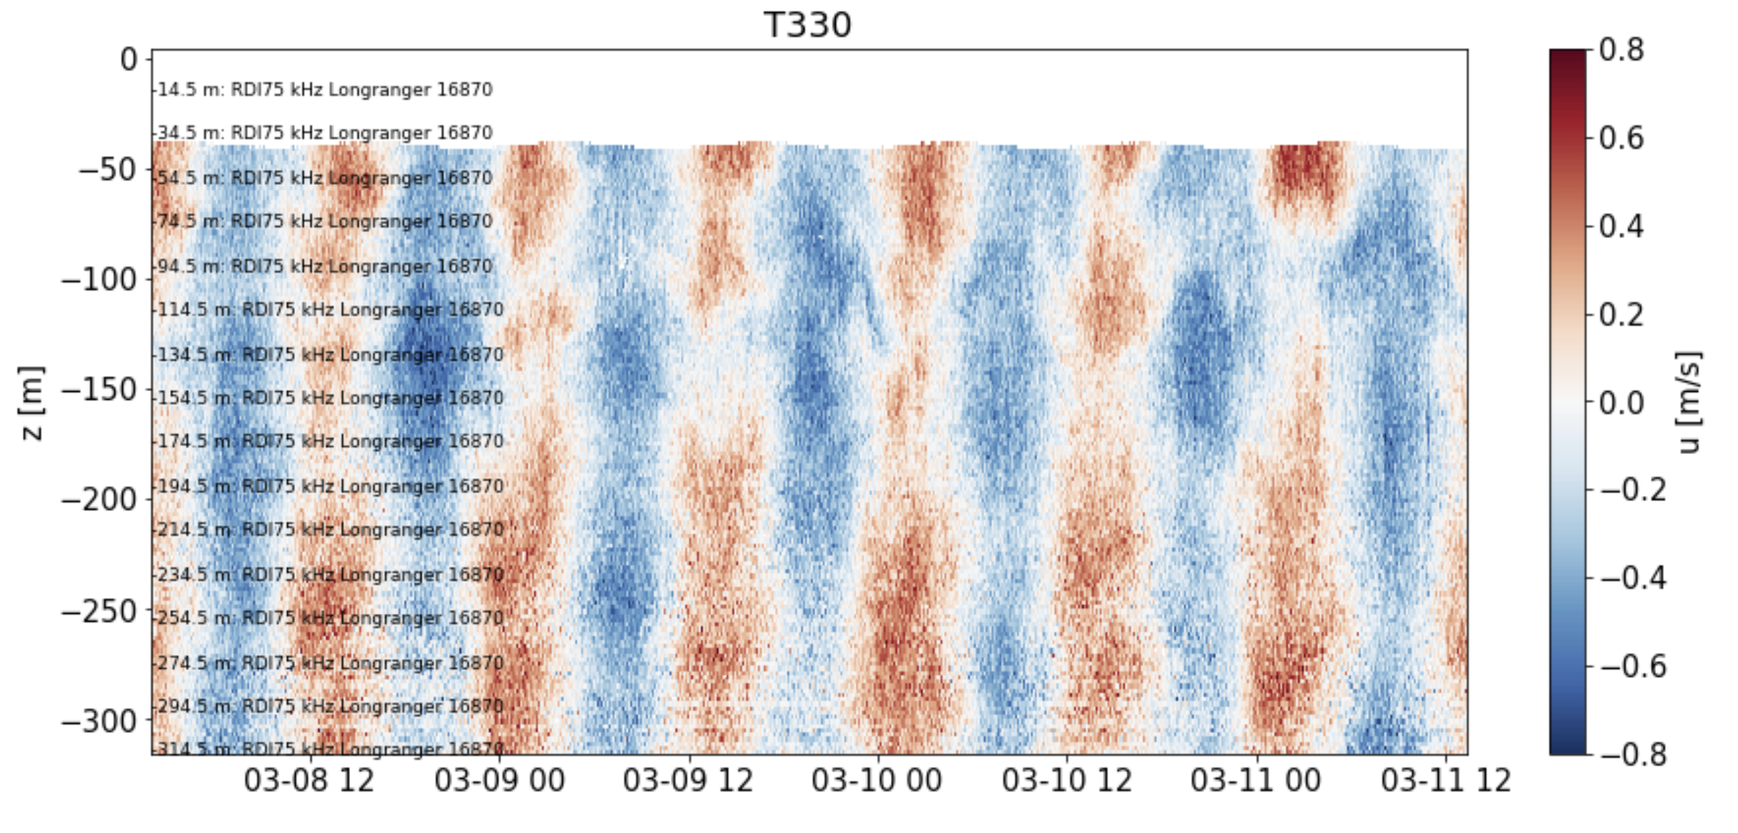
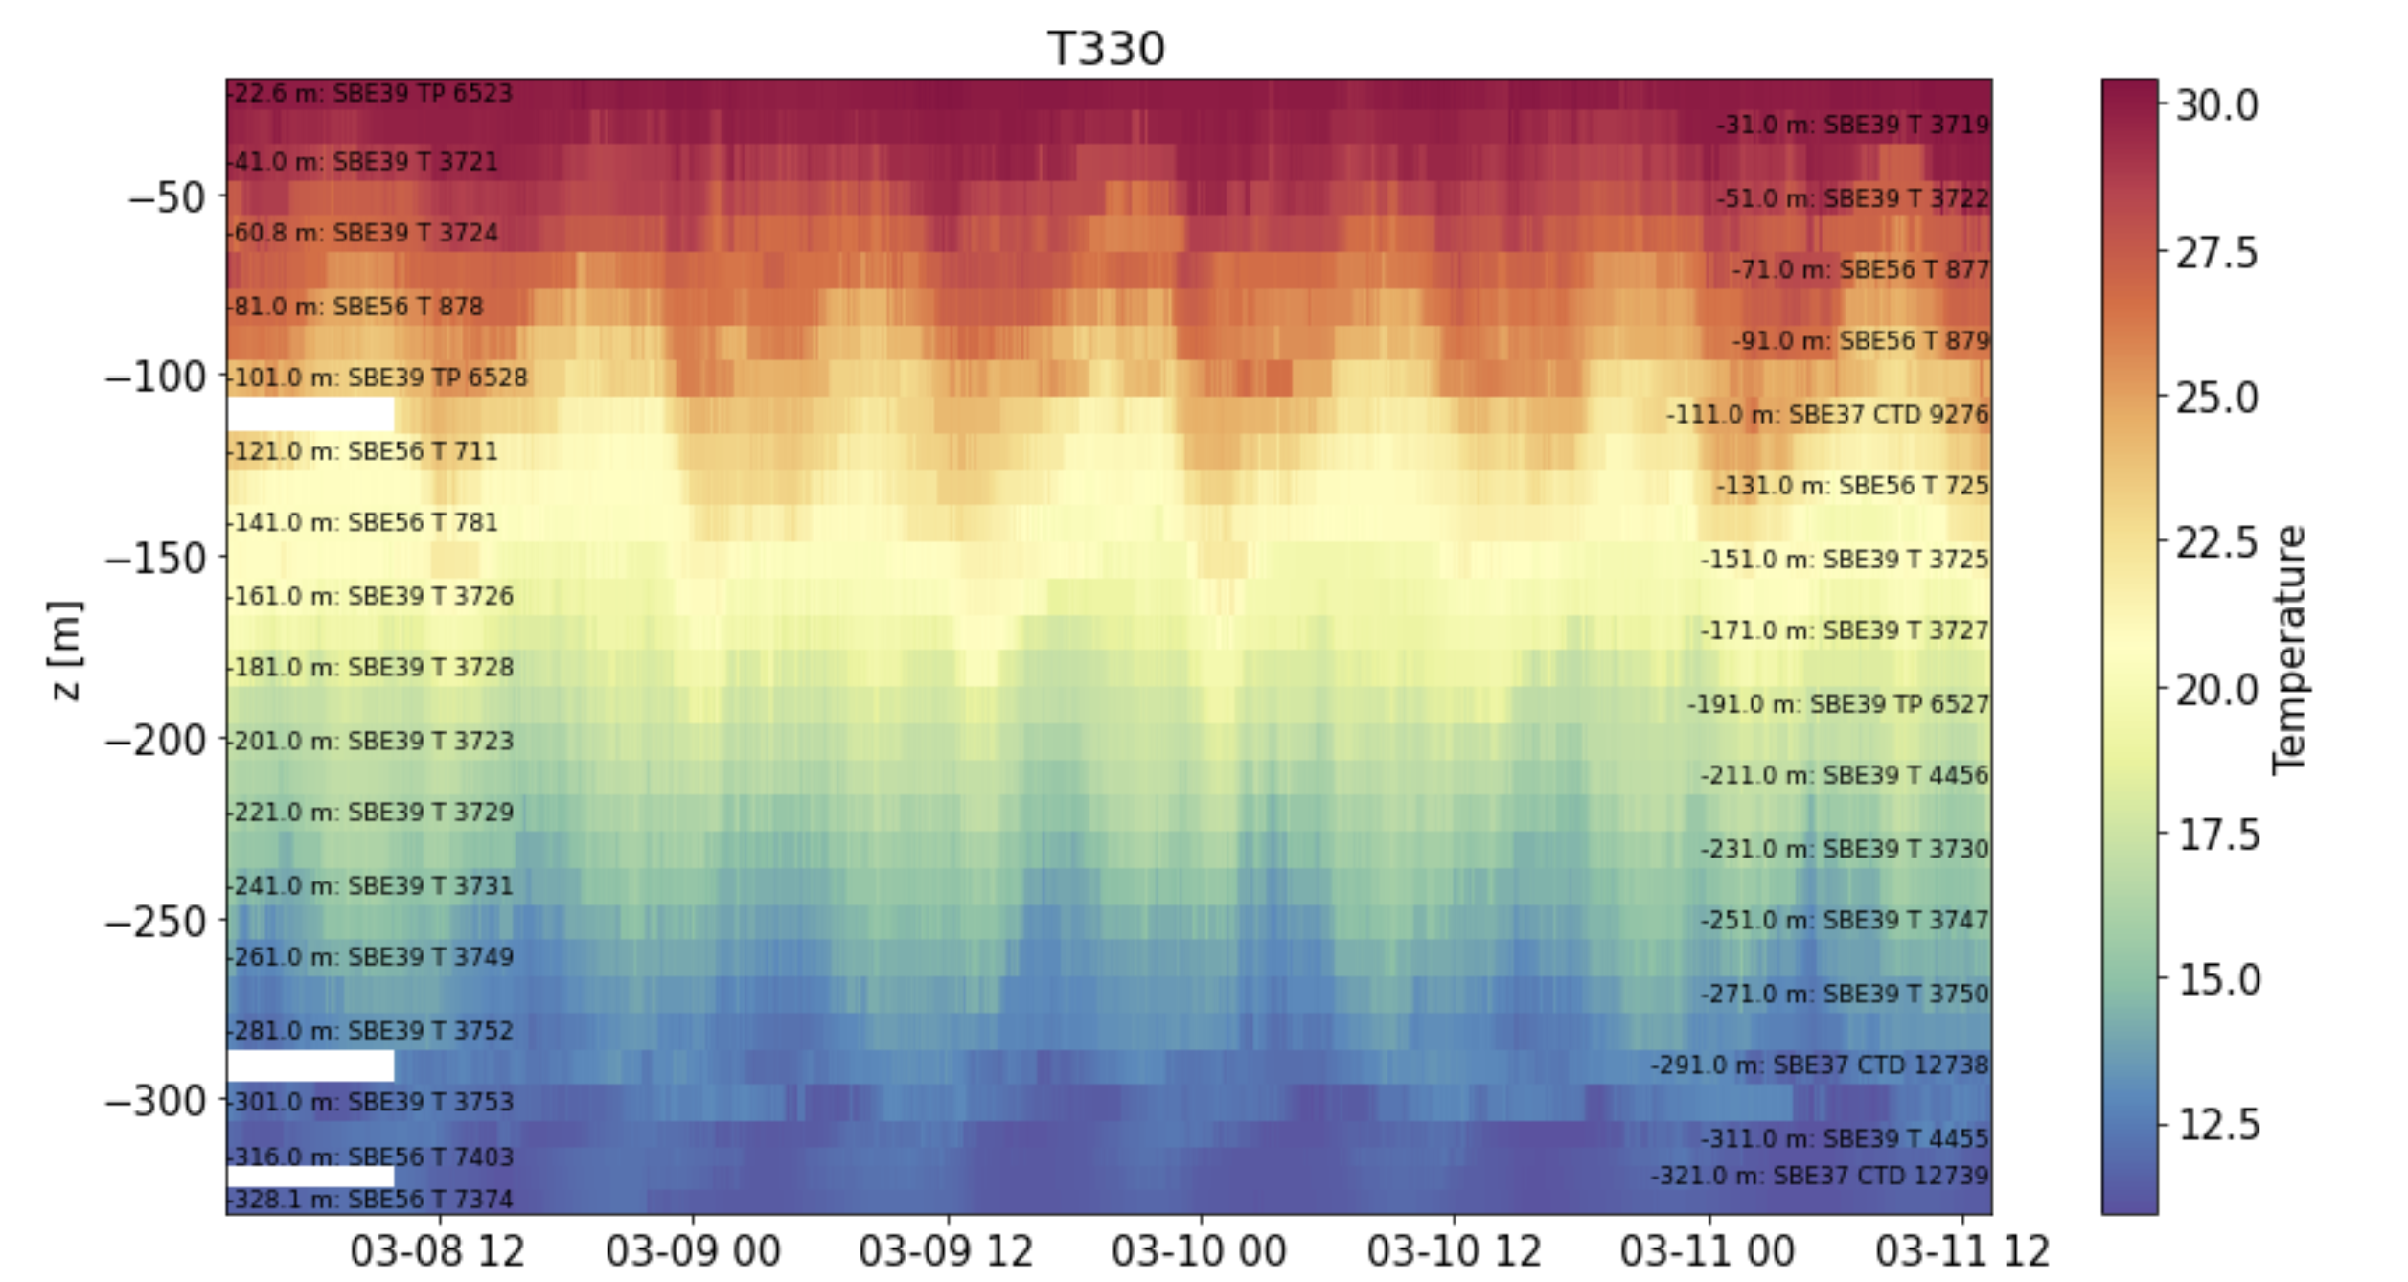
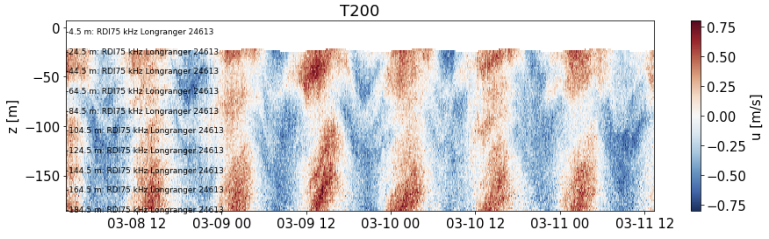
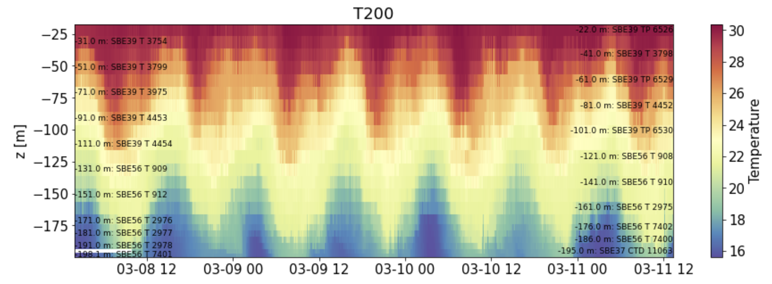
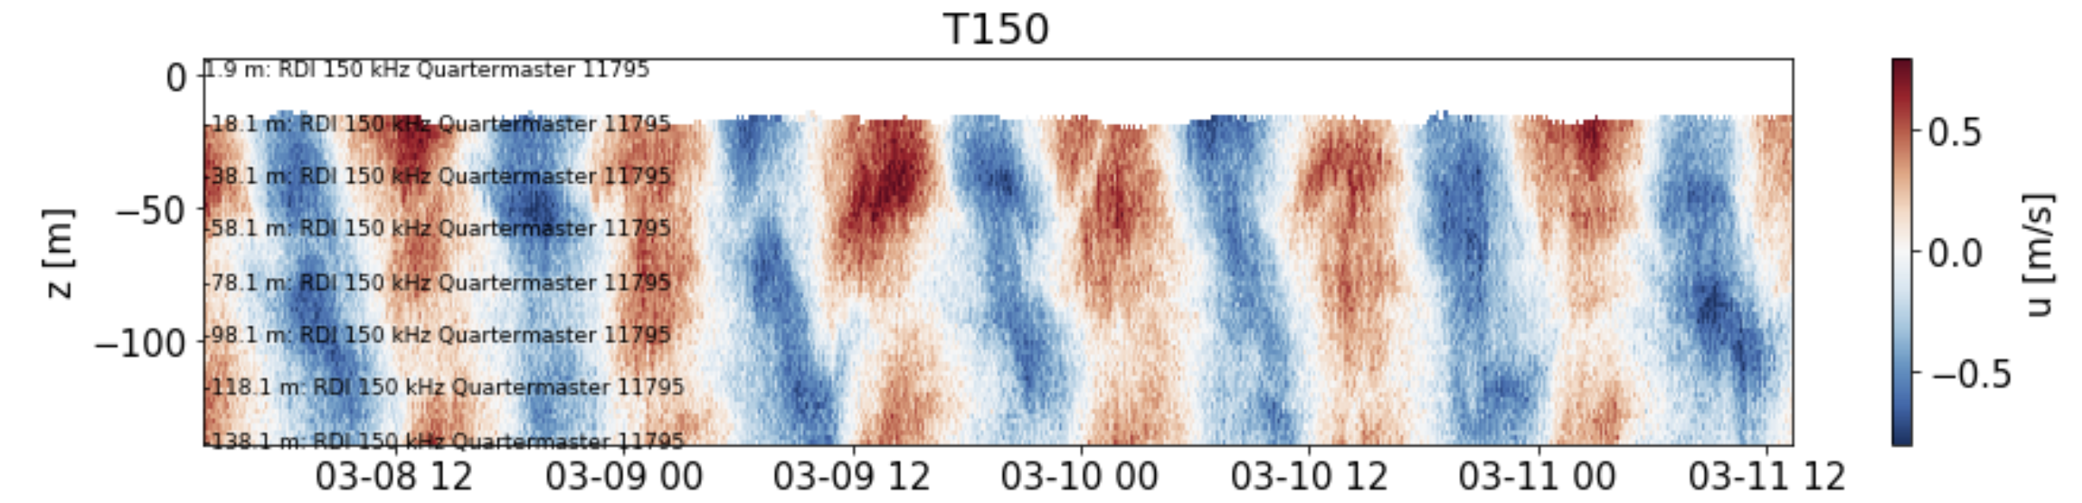
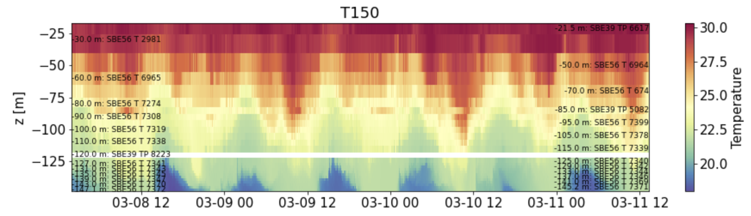
Pilbara Stacked Moorings

Slide 14
Next Steps…
Improve file structures/metadata, rerun
Onto Chris and Will to Finish Rowleys
Publish on library website
And then there are options…
Actually do more of the higher level processing
Hosted SQL database?
Cloud storage?

Slide 15
Related Repos
Dependencies
iosonobert/pyODAS [For Rockland Microstructure]
iosonobert/dallsporpoise [For Binary Read Of Corrupt Vec Files]
lkilcher/dolfyn [For Binary Read of Non Corrupt RDI/Nortek Files]
CW/Copylot [Don’t actually know yet]
Other
UHDAS+CODAS tools
mrayson/mycurrents
iosonobert/turbotools

Slide 16
The Recipe
Database
Simple CSV or PostgreSQL
Generic utilities
E.g. Complete suite of automated QC conventions (IMOS); CF compliance checker; “Mooring stacker”; Timeseries analysis; Despiking
Base class which handles all interactions with a dataset
E.g. Assigning QC codes with comments; Returning QC variables; Adding Comments; Tracking change history; Track processing applied; Ensuring CF compliance; Applying offsets
Super class per instrument which handles specifics
E.g. Link to reader files (multiple allowed - crucial); Actually format the dataset; Quick plotting tools; Apply a standard suite of QC codes
Instrument specific utilities
Rotations, transforms, bin mapping

Slide 17
Notebook structure
COMPLETE THIS.

Slide 18
2 Options
 | Simply archive all the previously processed data “as is” | Develop a suite of tools that can automate processing of a field trip from a metadata database (a recipe basically)
Pros | Capitalise on work already done Potentially the fastest | Greatest consistency Full record of what was done to the data and in what order Can have multiple process levels, all handled consistently and transparently Will pull together all the tools that we have into one place Effort is recoverable and recipe can be updated anytime If we change our mind about something, we update the “recipe” and rerun. If we update a file or a method, we can rerun a whole experiment easily Will get everything into one language
Cons | Effort not recoverable Don’t end up with a suite of tools to use for future trips Work done is split between Matlab and Python, so there would be a bit of duplication of efforts in the archiving stage This is already done to some extent with the AGU “FAIR” requirement | Will require more effort in total More difficult to see the progress until the end (i.e. until the recipe is complete)

